Slide 1


Welcome
from python import LIE
Python Language Immersion & Education Group

Slide 2
Master’s of the Trade

Slide 3
Mark Kiel, MD. PhD., CSO & Co-founder
Startup based on Python, Ruby, PERL, and JavaScript
(developer) Don’t worry about the big picture…?
Don’t think “that’s how it has always been done”
Be Agile
There are more jobs for code-capable data scientists than there are code-capable data scientists*
Essentially, you can name your own price

Slide 4
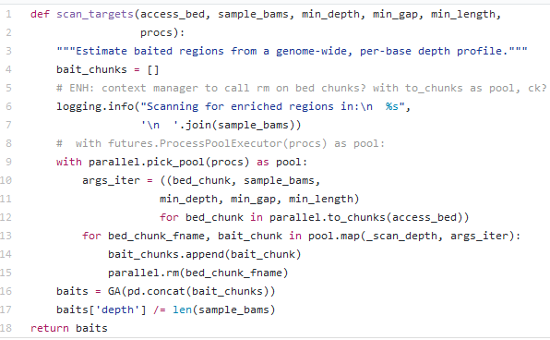
Code Review

Slide 5
What is a docstring?

Slide 6
PEP 257
A docstring is a string literal that occurs as the first statement in a module, function, class, or method definition. Such a docstring becomes the __doc__ special attribute of that object

Slide 7
Conventions
For consistency, always use """triple double quotes""" around docstrings. Use r"""raw triple double quotes""" if you use any backslashes in your docstrings.
Triple quotes are used even though the string fits on one line.
There's no blank line either before or after the docstring.

Slide 8
Style Guide
Sections:
Args: the arguments of your function/method/class
Returns/Yields: what your function passes back to your main program
Raises: What error your function will raise if something doesn’t fit
Warns: warnings that don’t stop program, but still inform incongruities
Etc..
Encouraged to type your variables (e.g. calling your argument an integer)

Slide 9
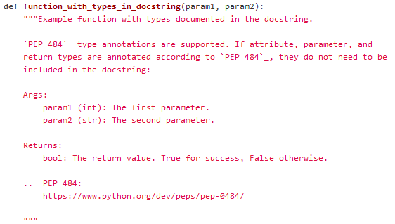
Example

Slide 10
Doctest
What is a doctest?
An additional comment in the code preceded by a >>> that gives a simple usage of the function and the expected output…but can be used as a rudimentary test framework

Slide 11
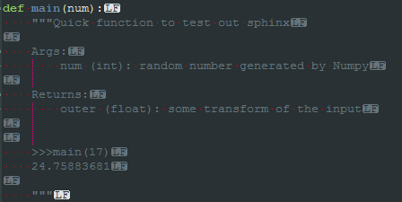
Example

Slide 12
Doctest usage
python -m doctest -v doctest_simple.py

Slide 13
Extensions
Using a package called mypy allows you to further type your variables & arguments.
This changes nothing about your program at runtime…only how certain linters and IDEs handle and debug your code.

Slide 14
Extensions
If you did a good job at documenting your code and you want to actually publish or share your code online. One of the first things you need to consider is the documentation, you can automatically populate a webpage with ALL of your docstrings for future users.

Slide 15

Sphinx is a python package that comes in your anaconda build that will automagically generate HTML of your documentation.

Slide 16
Live Demo

Slide 17
CLI help prompt
Docopt is a python package that uses your docstrings to automatically formulate a help prompt for your package. Go to
https://github.com/betteridiot/PotW/blob/master/Notebooks/docopt.ipynb

Slide 18
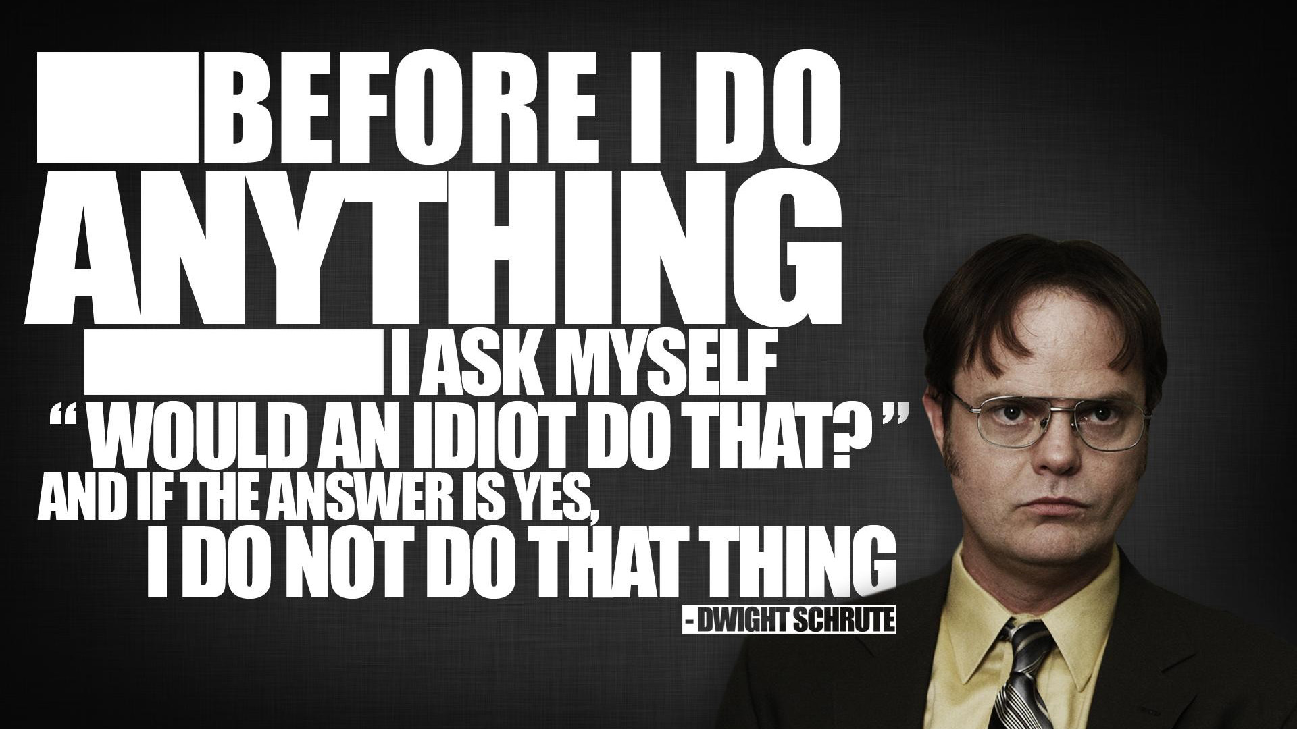

Slide 19

Code_Fight(P1, P2)

Slide 20
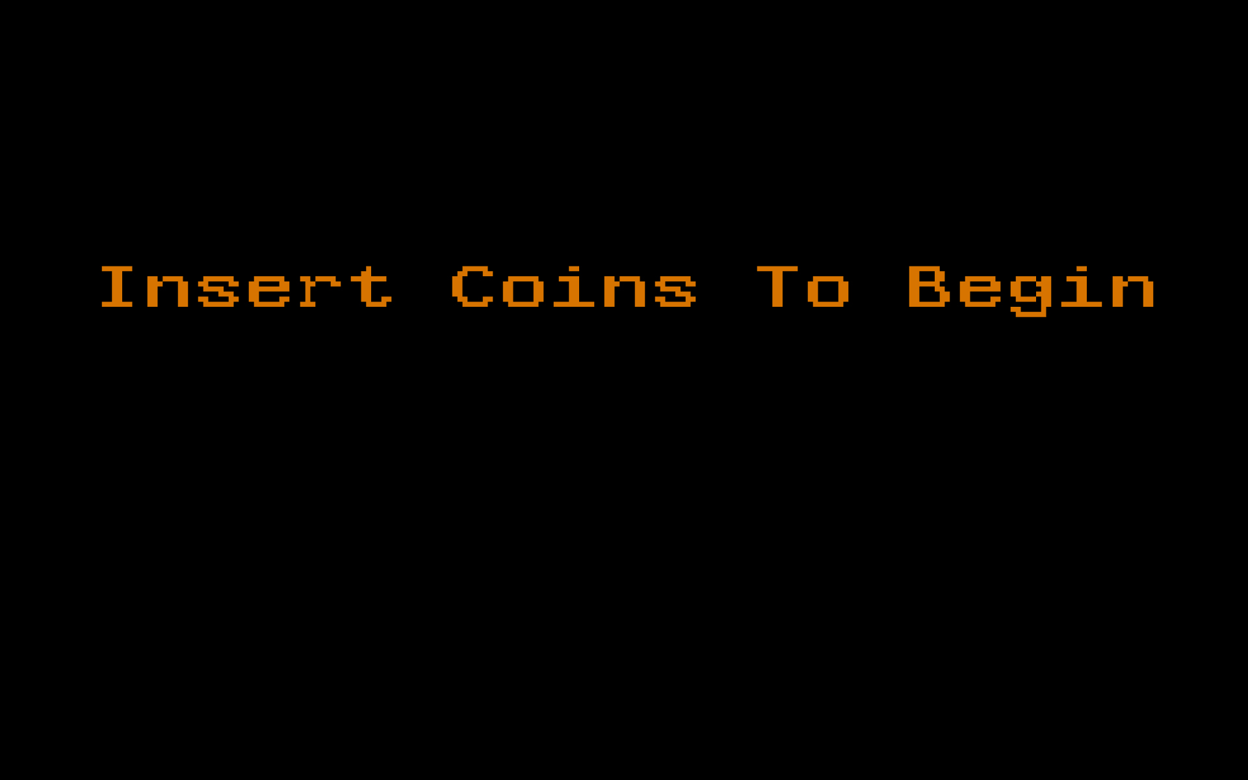

Slide 21
fizzbuzz(integer)
Write a function that takes an integer and returns “fizz” if the number is divisible by 3, “buzz” if it is divisible by 5, “fizzbuzz” if it is divisible by 3 & 5, or returns the number as a string if none of the other conditions are met.
Args:
integer (int): an unsigned integer
Returns:
out (str): string reporting evaluation of int
>>> fizzbuzz(15)
fizzbuzz
>>> fizzbuzz(3)
fizz
>>> fizzbuzz(2)
2

Slide 22

Interview Question
How many different ways can you paint a cube with three colors of paint?

